Slide 1
Text-to-Image synthesizer

Slide 2
Agenda
Introduction
Team members
Tools
Project flowline
Dataset
StackGAN
Real example

Slide 3

Introduction
In our project, "Text-to-Image Synthesizer," we focus on generating photorealistic images from textual descriptions. To address this complexity, researchers have developed solutions using StackGANs (ST-GANs), an architecture where two Generative Adversarial Networks (GANs) are stacked, each contributing to progressively refine and enhance the quality of the generated images.

Slide 4
Team Members
Basmala Saad
Gehad Mohamed
Mariam Magdy
Mustafa Hesham

Slide 5
Tools

Slide 6
Tools
Python
Pandas
OpenCV
NLTK
Tkinter
StackGAN

Slide 7
Project flowline

Slide 8
Project flowline
Image Preprocessing
Text
Preprocessing
Data
Split
Stage I
Stage II
GUI

Slide 9
Image Preprocessing
Loading filenames, bounding boxes, and image labels
Cropping images using bounding box coordinates
Resizing images to 360x360 pixels
Saving processed images

Slide 10
Text Preprocessing
Loading captions
Cleaning and tokenizing captions
Stopword removal and lemmatization
Processed captions

Slide 11
Data Split
The data is split into training and testing sets based on a predefined file (train_test_split.txt), which specifies which images go into the training set and which go into the testing set. This ensures that the division is consistent and repeatable.

Slide 12
Stage I (Rough Image Generation)
Define the Generator and Discriminator
Implement Loss Functions
Training Stage I

Slide 13
Stage II (Refining Image Details)
Define the Second Generator and Discriminator
Implement Loss Functions
Training Stage II
Evaluation and Refinement

Slide 14
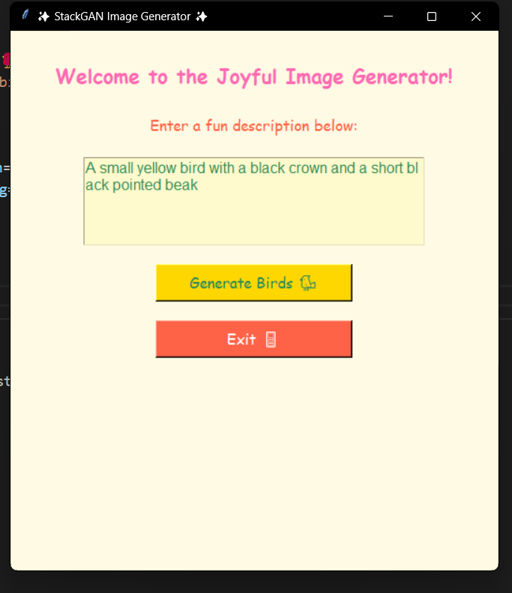
GUI
We have built a simple user interface using tkinter.

Slide 15
dataSet

Slide 16
Dataset exploring
CUB dataset contains 200 bird species with 11,788 images. Since 80% of birds in this dataset have object-image size ratios of less than 0.5 , as a pre-processing step, we crop all images to ensure that bounding boxes of birds have greater-than-0.75 object-image size ratios.

Slide 17
Stacked Generative Adversarial Networks

Slide 18
StackGan
Is a type of GAN used for generating high-quality images from text descriptions. It works in two stages to progressively generate more detailed images.

Slide 19
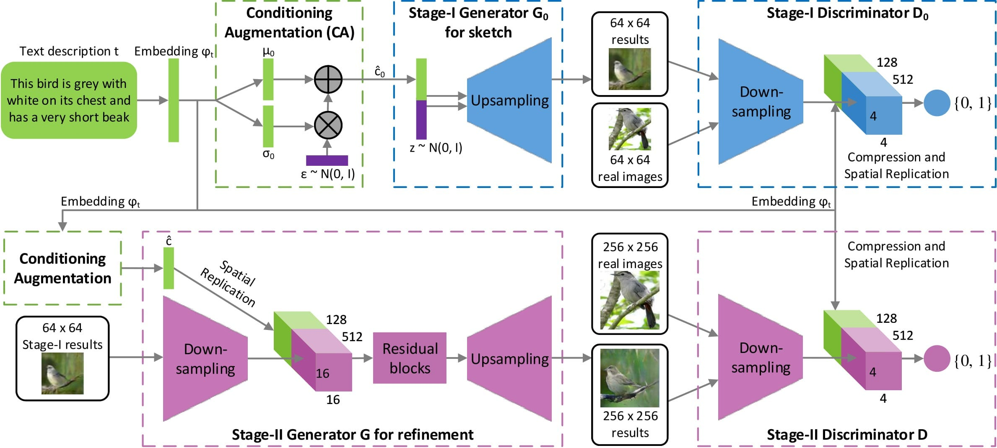
Model Architecture of StackGAN

Slide 20
How this synthesizer works?

Slide 21
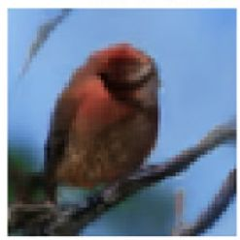
Step 1
This bird is red

Slide 22
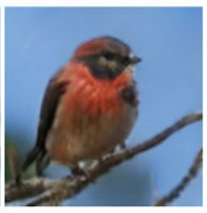
Step 2
This bird is red with white

Slide 23
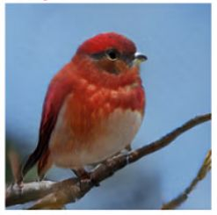
Step 3
This bird is red with white and has a very short beak

Slide 24
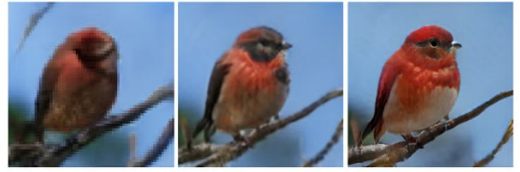
Full example
This bird is red with white and has a very short beak

Slide 25
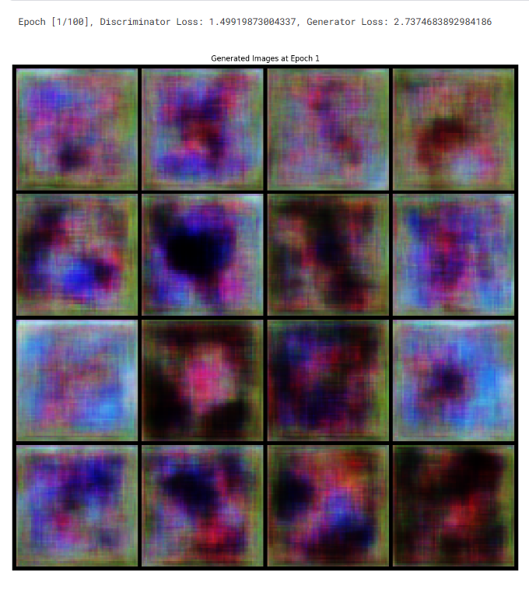
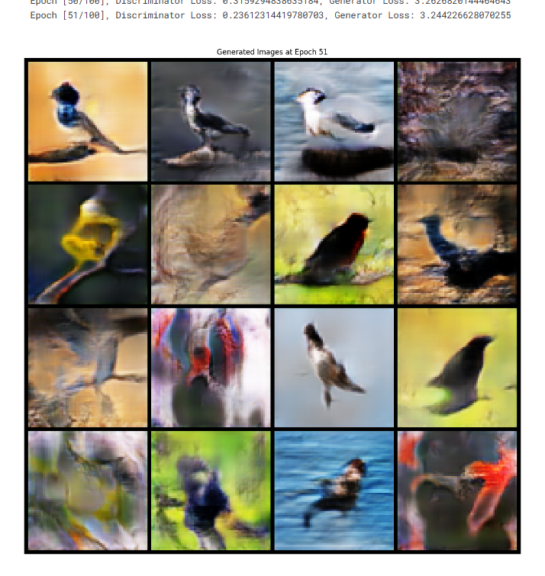
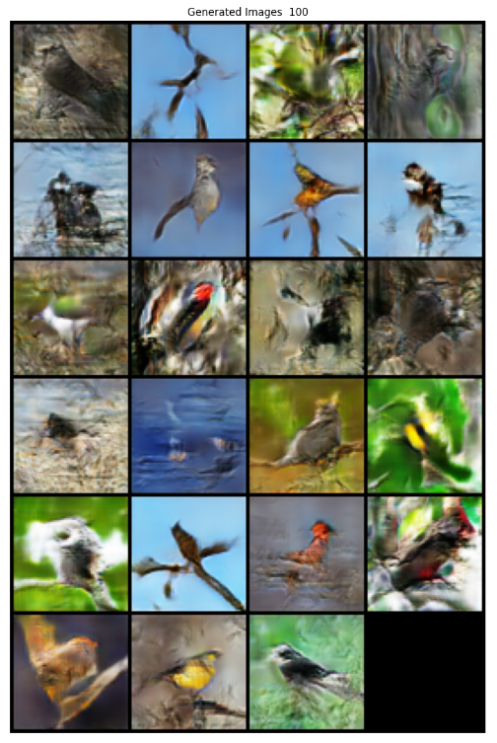
Stage I Training results

Slide 26
Thank You

